Slide 1
Automated System for Student Behaviour Monitoring in Classroom.

Slide 2
Team members :
Name PRN
Yogesh Chillal 17UCS12004XX
Pratik Durukkar 17UCS12010XX
Swaranjali Magdum 17UCS11029XX
Shravani Narvekar 17UCS51035XX
Siddharth More 18UCS72008XX

Slide 3
Problem statement :
An automated system for generating the detailed report of monitoring the students activities as well as the attendance in the class room.

Slide 4
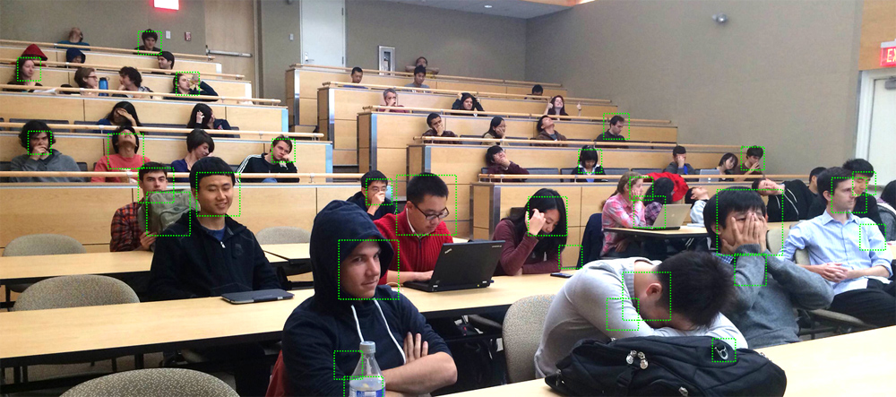
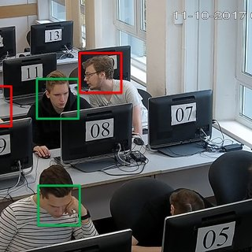
Introduction :

Slide 5
Objectives :
To detect faces and recognize them for attendance.
To detect student’s attentiveness and behaviour in class room during lectures

Slide 6
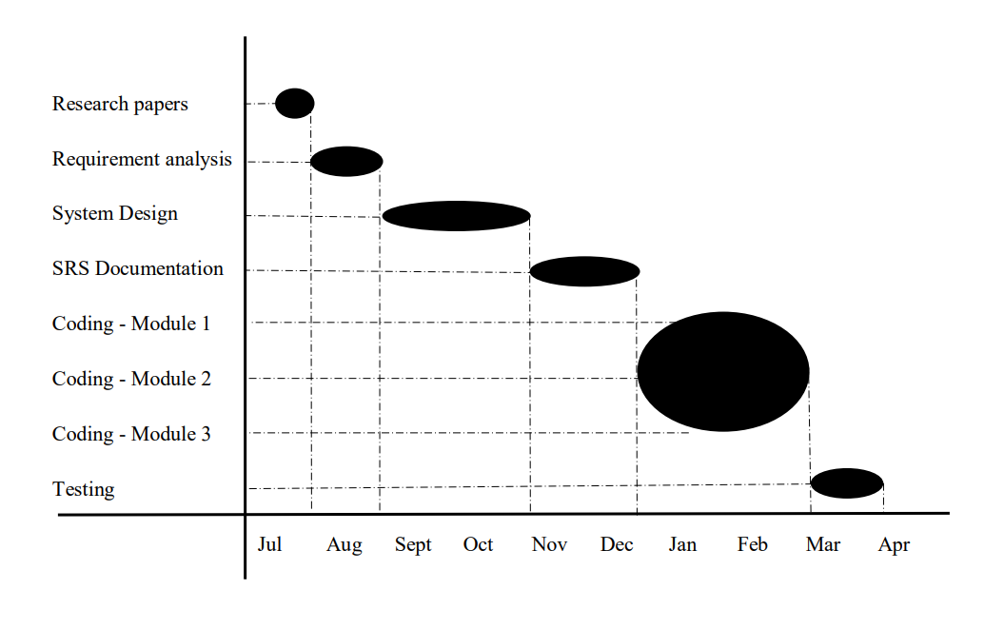
Timeline of the Project

Slide 7
Literature overview:
“Are lectures the best way to teach students?”
Lecture halls and lectures, describing their darkness, endless PowerPoint slides, and the distraction of students themselves and others when browsing the web and social networks.
71% of teachers thought technology damaged students’ attention
64% people who took another survey said that technology did more to distract students than to help them academically
To overcome this problem in the universities many came forward to provide a solution

Slide 8
Investigation of current project and related work
Visualization Analysis of Learning Attention Based on Single-image.
This paper proposed the technique of real time capturing the image of the classroom and checking whether the students are paying attention in the lecture by estimating the head pose of each student.
Only head pose estimation will not work as students may just keep their head up towards the camera while taking the image and later do anything they want.
Automated Classroom Monitoring With Connected Visioning System.
This paper proposed the technique of using IoT technology.
However this module worked very efficiently but the amount of resource and human power required was more

Slide 9
Investigation of current project and related work
Classquake: Measuring students’ attentiveness in the classroom
This app uses students’ smartphones as decentralized sensors to measure their activity and attentiveness during lectures
However this could only determine the use of mobile phones in the classroom and is not the proper solution for the problem. We will not be able to find the student who is using the mobile phone.
Sleep Gesture Detection in classroom monitor system
This paper proposes the technique of using the images of students sleeping in a classroom as a dataset and then training the model for detecting the sleeping students in a real classroom
There is no need automated system for this purpose. As everything must be done manually it is more time consuming and not that worth.

Slide 10
Investigation of current project and related work
Now coming to the conclusion from the above four papers that some of the systems proposed are useful but have drawbacks.
Considering all the above solutions we came up with a new effective solution. This system will take the attendance as well as check the attentiveness of the student automatically.
Also generate a report of the students who were present and who were active and inactive.
Our proposed solution is fully automated and does not require a lot of resources.

Slide 11
Requirement Specifications :
SR.NO | Requirement | Essential or Desirable | Description of the requirement | Remarks
RS1 | The system should provide database to store login credentials | Essential | This will store the registration data entered by faculty. | Registration is available for faculty only.
RS2 | The system should have a login | Essential | A login box should appear when the system is invoked. | The logins are available for registered faculty only.
RS3 | The system should crosscheck entered details | Essential | To crosscheck the entered details with the details present in the database. | It ensures the security of the faculty.
RS4 | System should inform about wrong login | Desirable | System should be able to inform the user when wrong login id or password is entered. | Only correct credentials are accepted.
RS5 | The system should provide a database to store the images of student’s face. | Essential | This will help in identifying the student’s face. | For taking the attendance.

Slide 12
RS6 | The system should detect and recognize the face of the students. | Essential | When the student’s image /video is seen by the system it will mark the attendance. | Mark the attendance correctly with the face and name of student.
RS7 | System must perform eye gaze tracking. | Essential | This will check if the student is not sleeping. | If found sleeping count time.
RS8 | System should recognize the student who was sleeping | Essential | Helpful to mark the behavior. | Mark the behavior correctly with the face and name of student.
RS9 | System should calculate the attendance and make behavioral analysis of student | Essential | This will give the behavioral analysis of all the students. | Mark the attendance only if student was active.
RS10 | System should provide database to store the attendance and behavioral analysis. | Essential | Helpful in keeping the record of the students. | Proper information of student available easily.
RS11 | System should generate report. | Essential | To make the proper decisions on students as well as teaching techniques. | Proper information of student available easily.

Slide 13
Hardware Requirements:
Hardware | Specifications
Processor | Intel core i5 or later
64 bit OS | -
RAM | Minimum 4GB
Secondary storage | Minimum 8GB
Camera | Minimum 2MP
Software Requirements:
Software | Alternative(if available)
Windows 7 or later with MS office | Not available
SQL Server | Not available
Python Programming language | Not available

Slide 14
System Analysis:
Algorithmic description of each modules:
Our system is mainly divided into three different modules-
Face detection and recognition module
Eye-gaze tracking/ drowsiness detection module
Behaviour analysis module

Slide 15
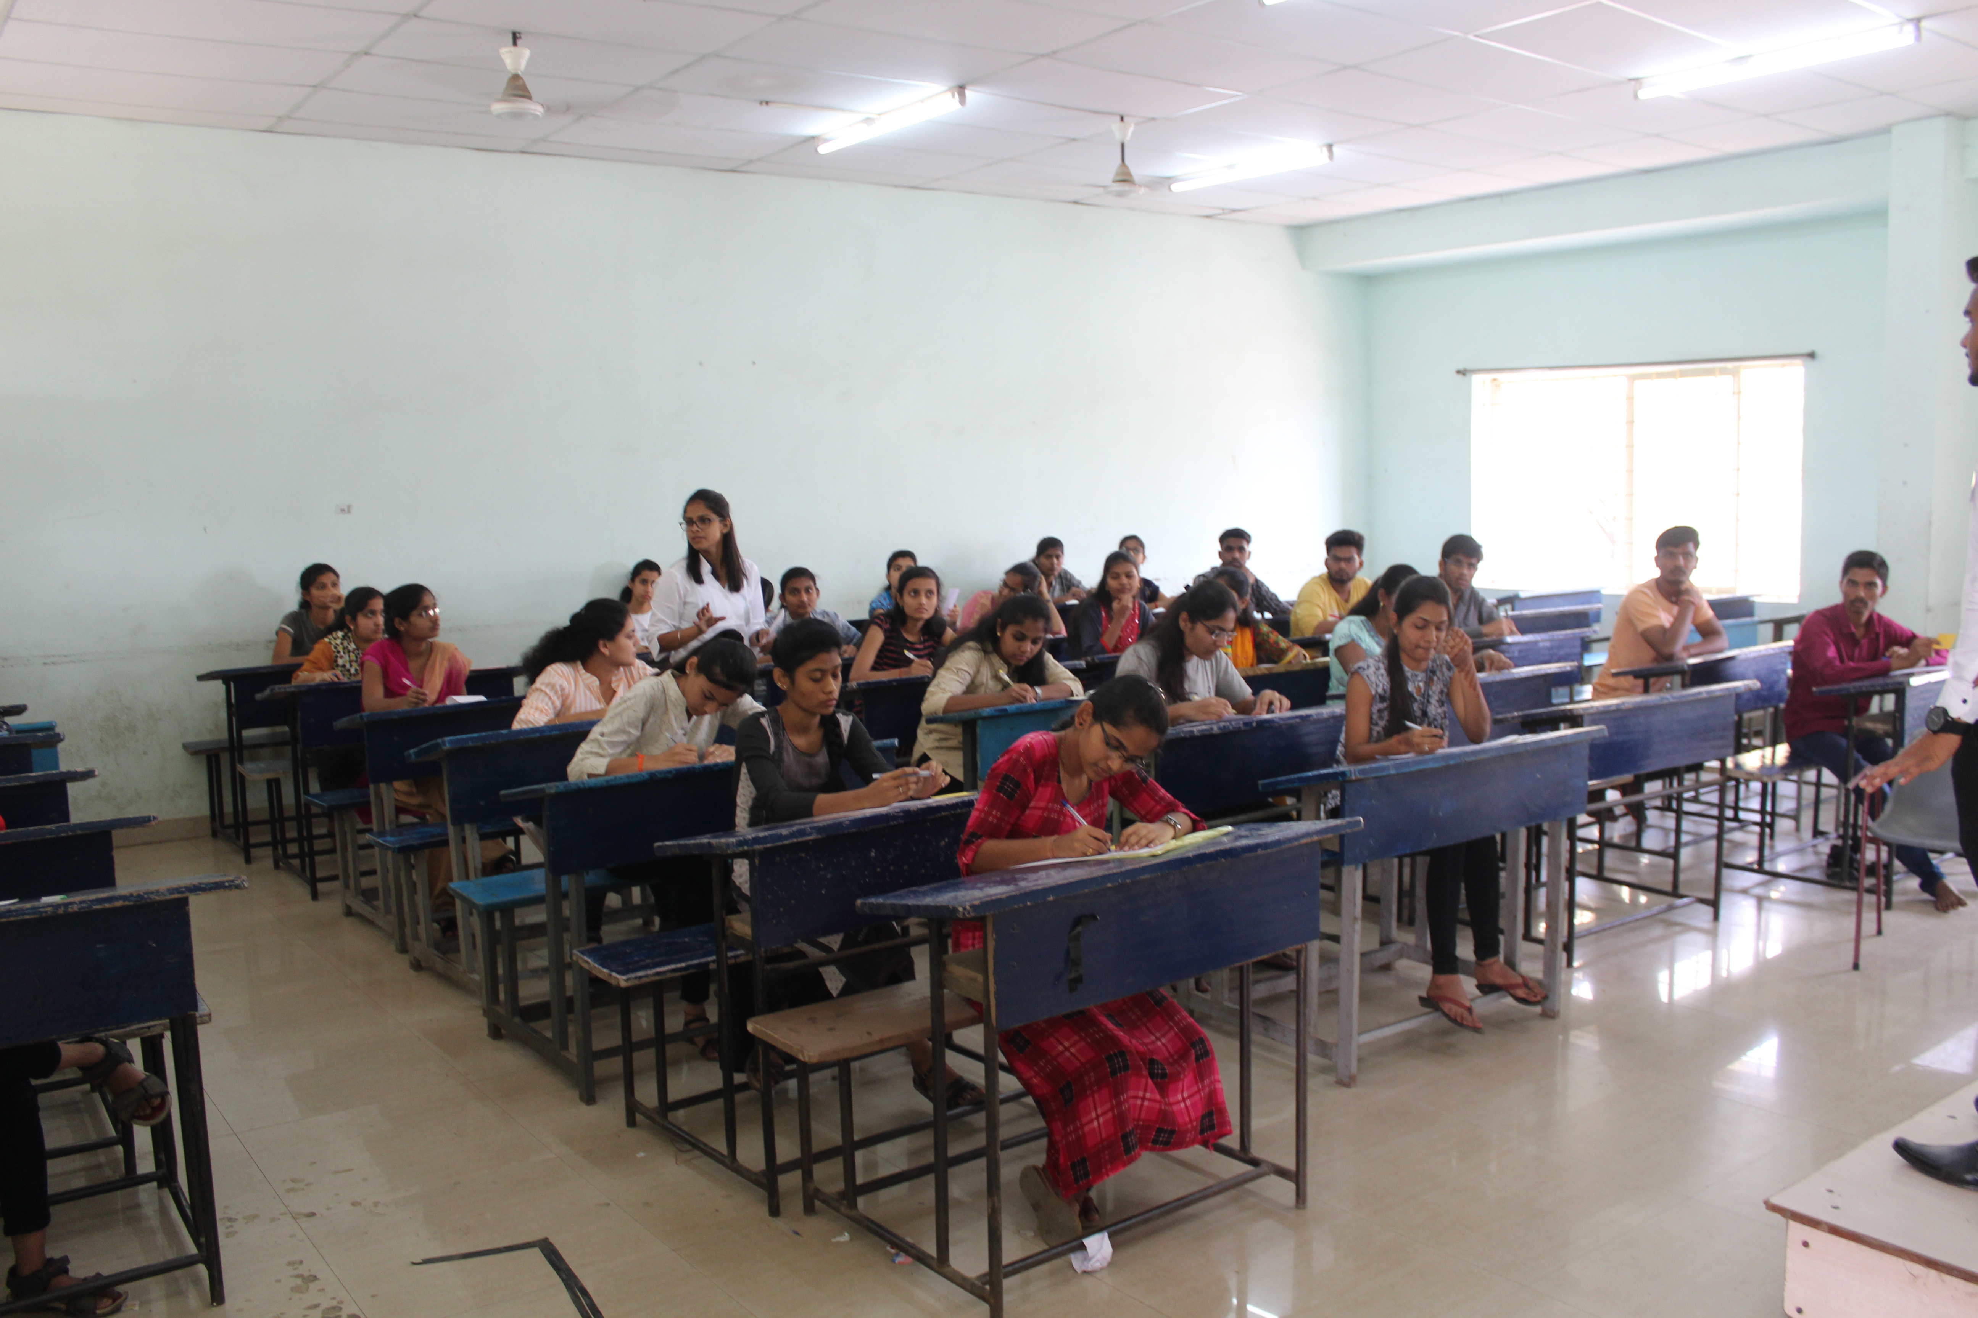
1.Face detection and recognition module
Face detection
Behavioral analysis module
Face Recognition
Face Database

Slide 16
2. Eye-gaze tracking/ drowsiness detection module
Eye gaze tracking
Drowsiness detection
Behavioral analysis module
Face Recognition
Face Database

Slide 17

3. Behaviour analysis module
Face detection and recognition module
Eye gaze tracking/ drowsiness detection module
Attendance calculation and behavioral analysis
Database
Report generation

Slide 18
Implementation:
Implementation details for Registration of student:
For this purpose we used modules such as OS module and CV2 module.
os.path.join () -method we merged the main directory where all the registered students are present with the new registration
os.mkdir () - method is used to create new directory.
VideoCapture () - method is used to get a video capture object form the camera
imwrite () - method is used to save an image in the directory
face_recognition.face_encodings() - To create encoding

Slide 19
Implementation:
Implementation details for Face detection and recognition:
Face recognition module consists of three main steps which are image preprocessing, then face detection can be done by using suitable algorithms and last one face recognition.
VideoCapture.read ()- input can be taken
cv2.cvtColor () - convert that RGB image into gray scale
detectMultiScale (gray, 1.5, 5)- returns 4 values — x-coordinate, ycoordinate, width(w) and height(h) of the detected feature of the face.
cv2.rectangle() - Based on these 4 values we will draw a rectangle around the face.
Pip install face_recognition & Import face_recognition
face_recognition.face_encodings() - To create encoding
face_recognition.compare_faces() - to compare the current encoding with the encoding which created at the registration time.

Slide 20
Implementation:
Implementation for Eye gaze tracking:
Eye gaze tracking module consists of three main steps which Eye localization, Thresholding to find the white spaces of the eyes, determining if the “white” region of the eyes disappears for a period of time
The eye aspect ratio is instead a much more elegant solution that involves a very simple calculation based on the ratio of distances between facial landmarks of the eyes.
face_utils ()- To localize of facial landmark from the video input
eye_aspect_ratio() -For both left and right eye landmark EAR is calculated separately
ear = (leftEAR + rightEAR) / 2.0- for both eyes new EAR
If calculated EAR for both eyes is less than the threshold value (i.e. 0.25) then function return that the student is not active.

Slide 21
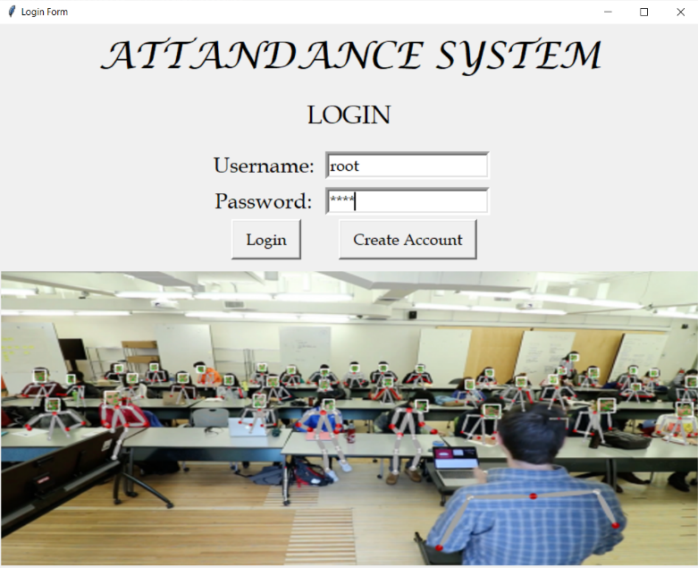
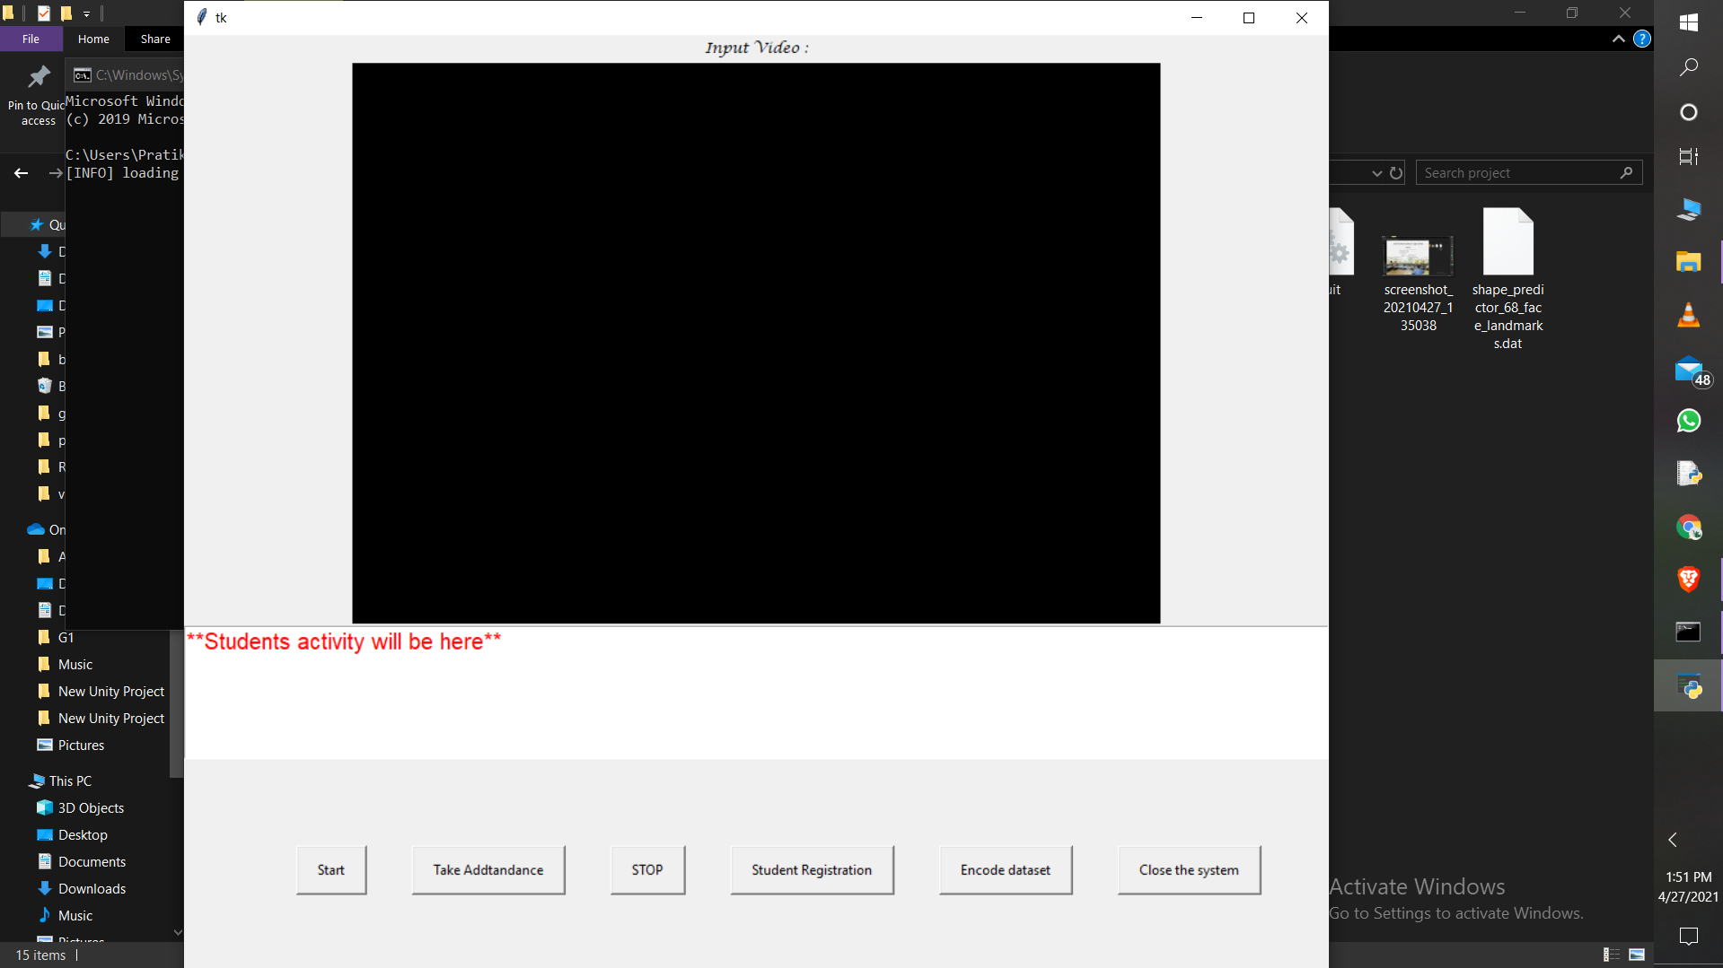
Integration and Testing

Slide 22
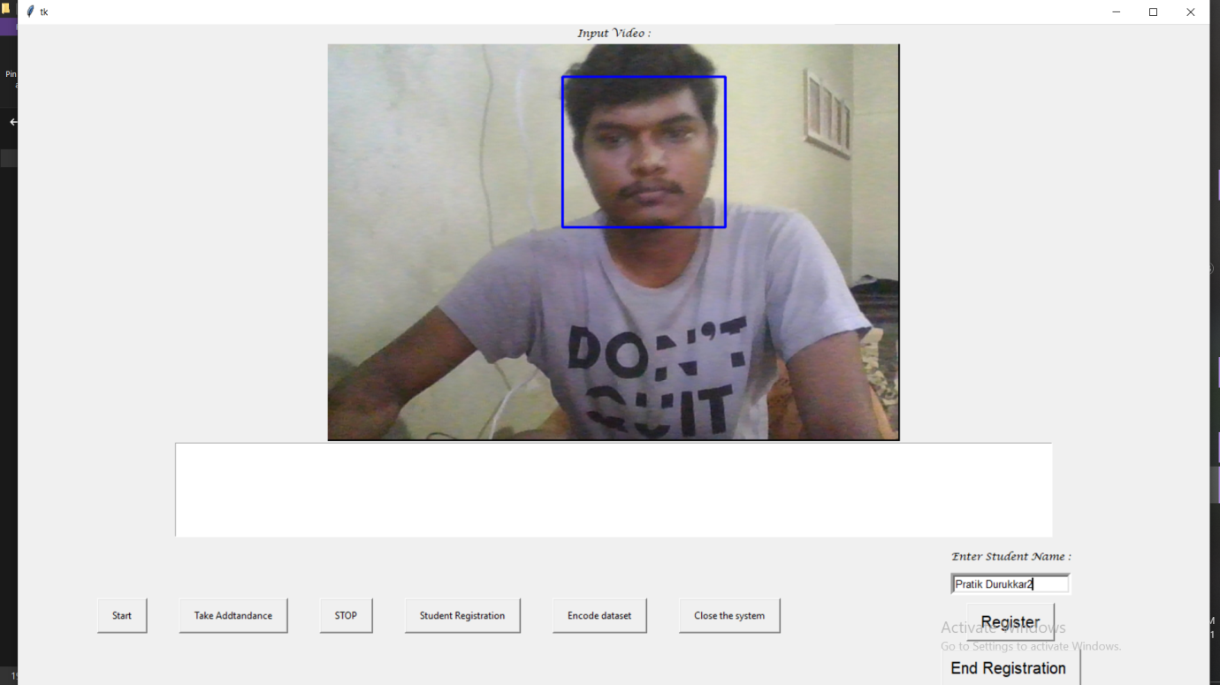
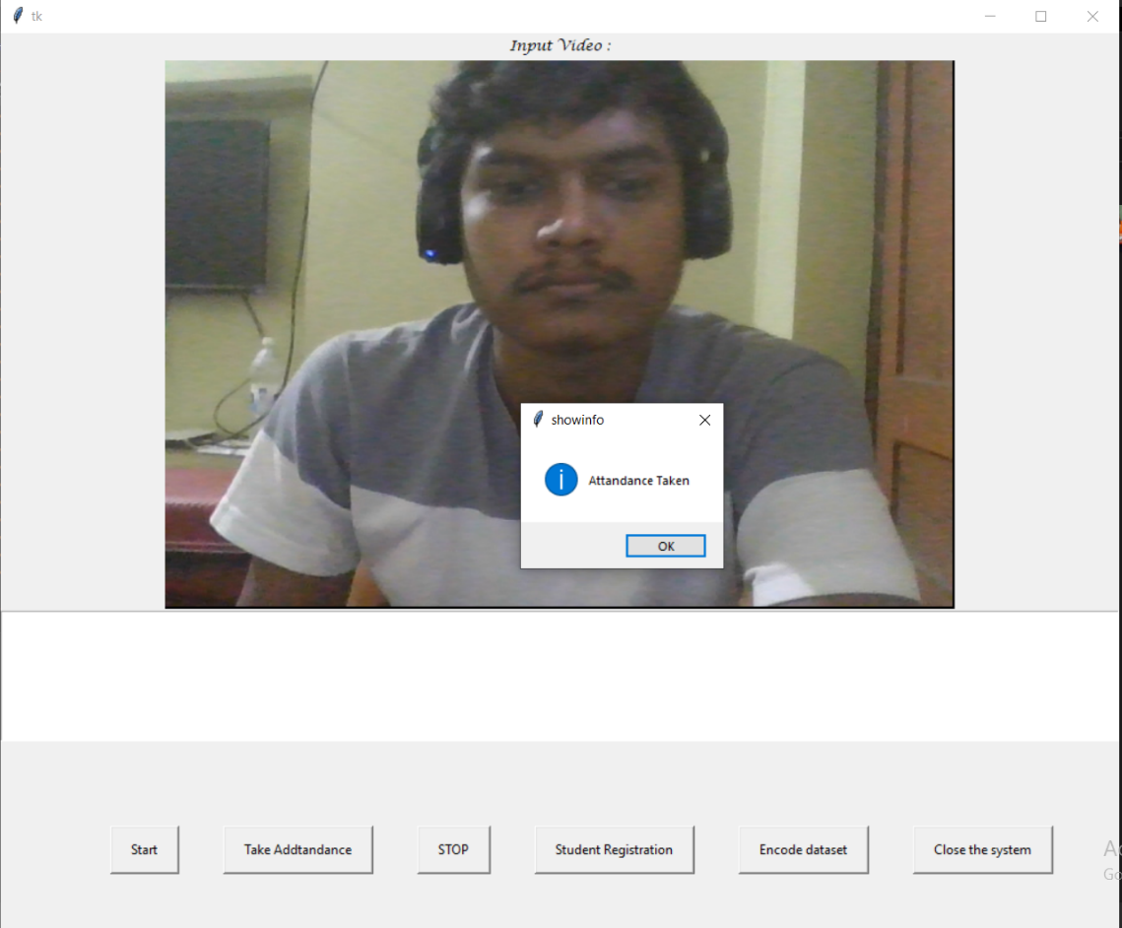
Integration and Testing

Slide 23
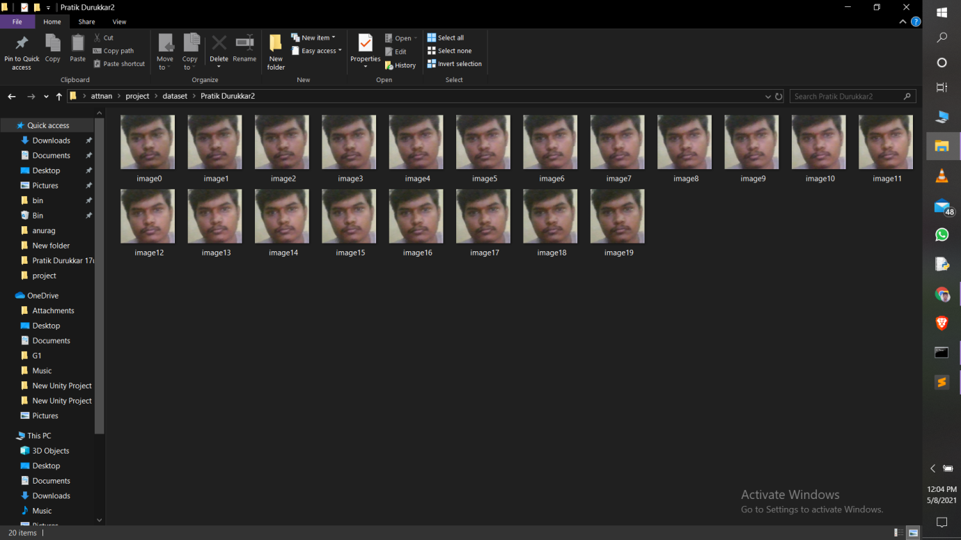
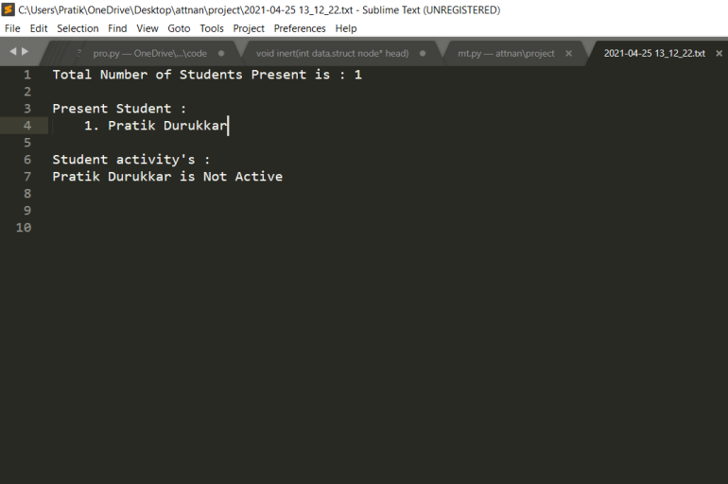
Integration and Testing

Slide 24
Performance Analysis
As per the requirements and the testing we can say that our system works in efficient manner. The system can successfully register the student and store the images of students with their names
The system can successfully capture the video and detect the face of the student and recognize the student.
The system can successfully perform the eye gaze tracking and tell the student is active or not. Finally the system can successfully generate a report of the attendance and the behaviour analysis of the student.
Depending upon the requirements and objectives of the project our system works in efficient manner and performance is up to the mark.

Slide 25
Applications:
Smart attendance management system.
Monitoring system for colleges and private classes.
It will be used for both physical and online lectures.
Drowsiness detection module helps to increase the accuracy of previous attendance system.
Behaviour analysis module generate report that helpful for both teachers and students for future improvement.

Slide 26
Future Scope and limitations:
As we are towards the online world, online class will be the future and our system may not work with online platforms.
Each and every student should be registered separately in the system.
If the student’s face hides behind other student or if face is covered, then the attendance will not be marked

Slide 27
Thank You!!

